Slide 1
Div Tag in CSS

Slide 2
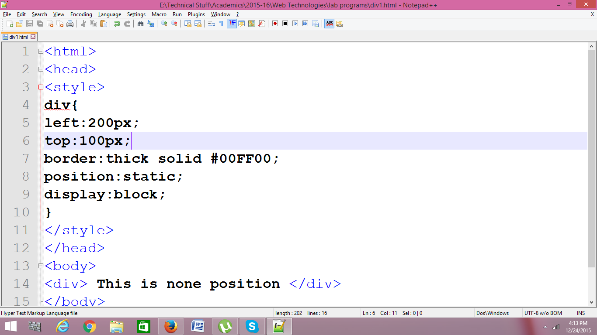
Position: Static

Slide 3

Output

Slide 4
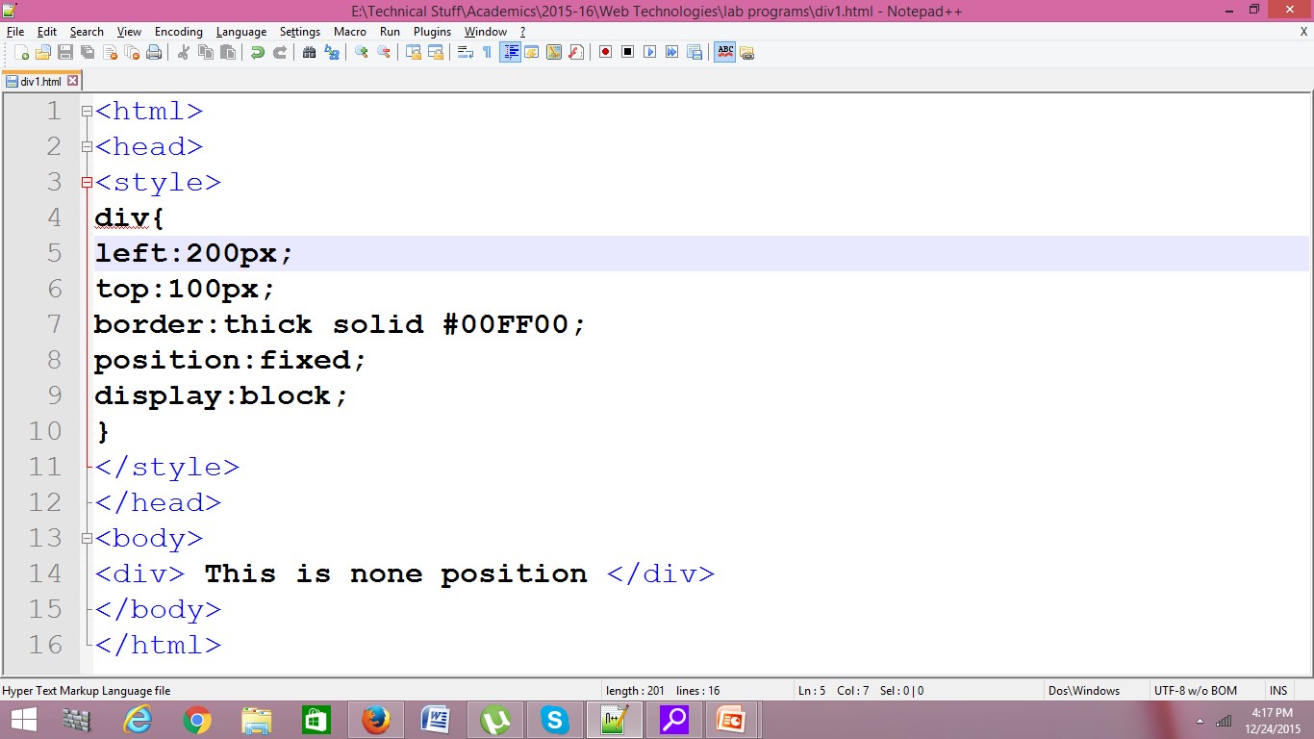
Fixed

Slide 5
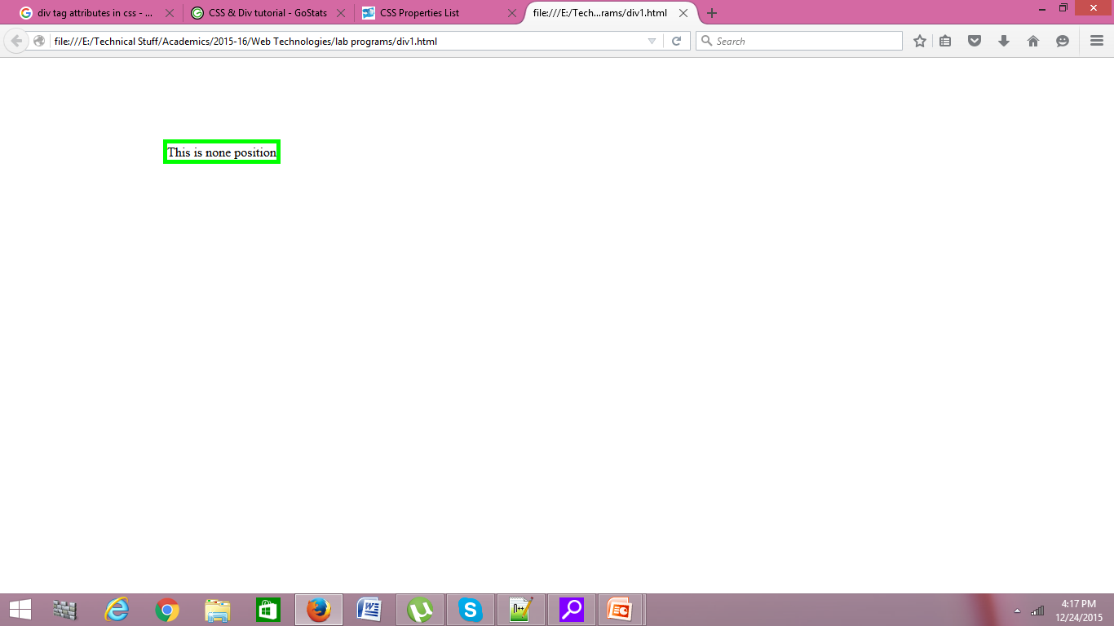
output

Slide 6
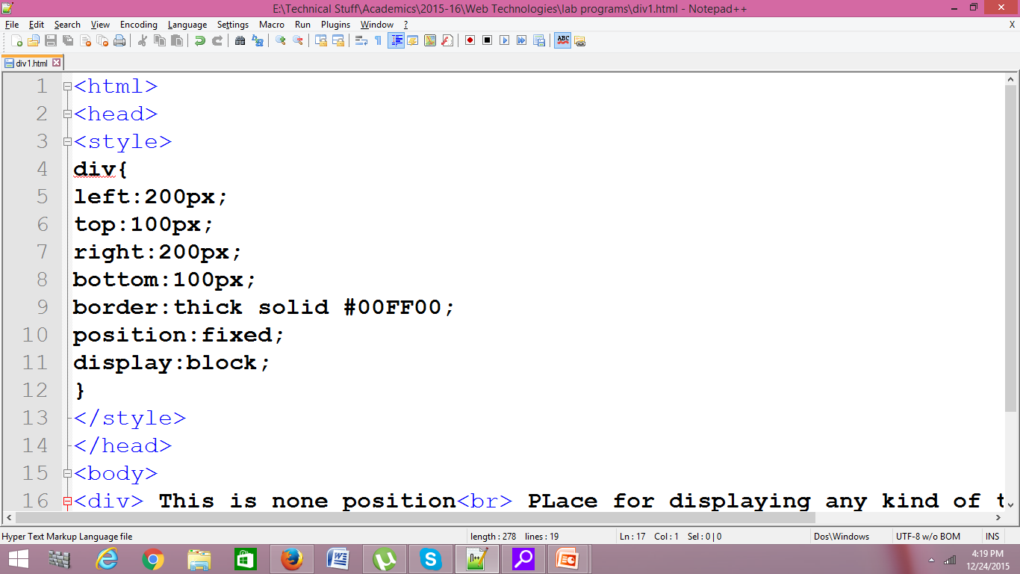
Fixed: Left,right,top and bottom

Slide 7
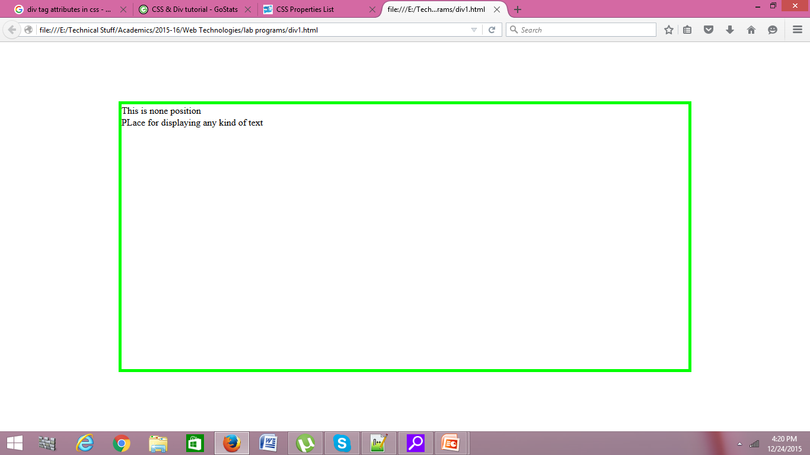
output

Slide 8
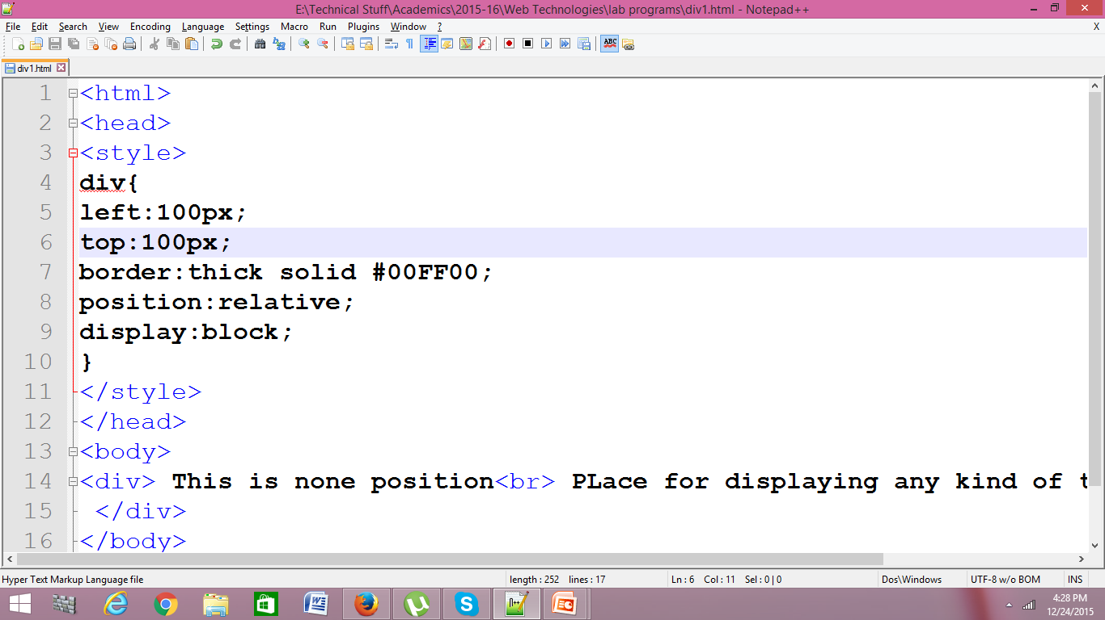
Position: relative
Start positioning from specified left and top but the length will be as of static

Slide 9
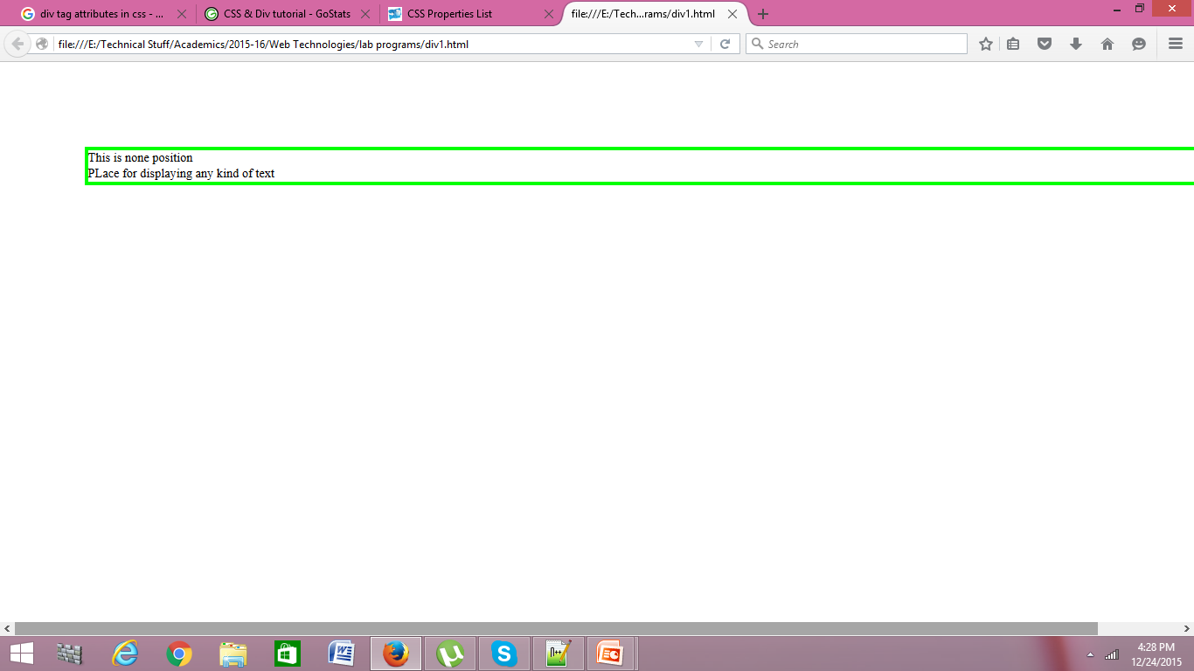
output

Slide 10
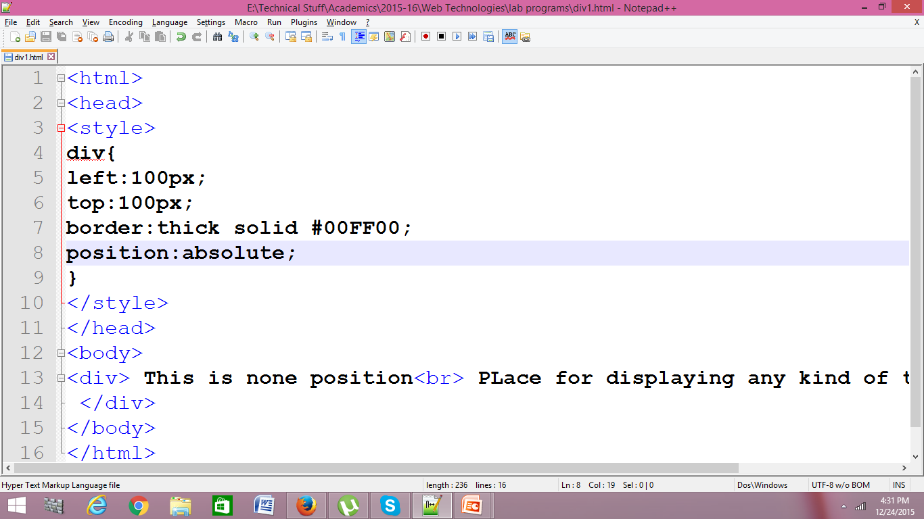
Position : absolute
This is same as fixed positioning

Slide 11
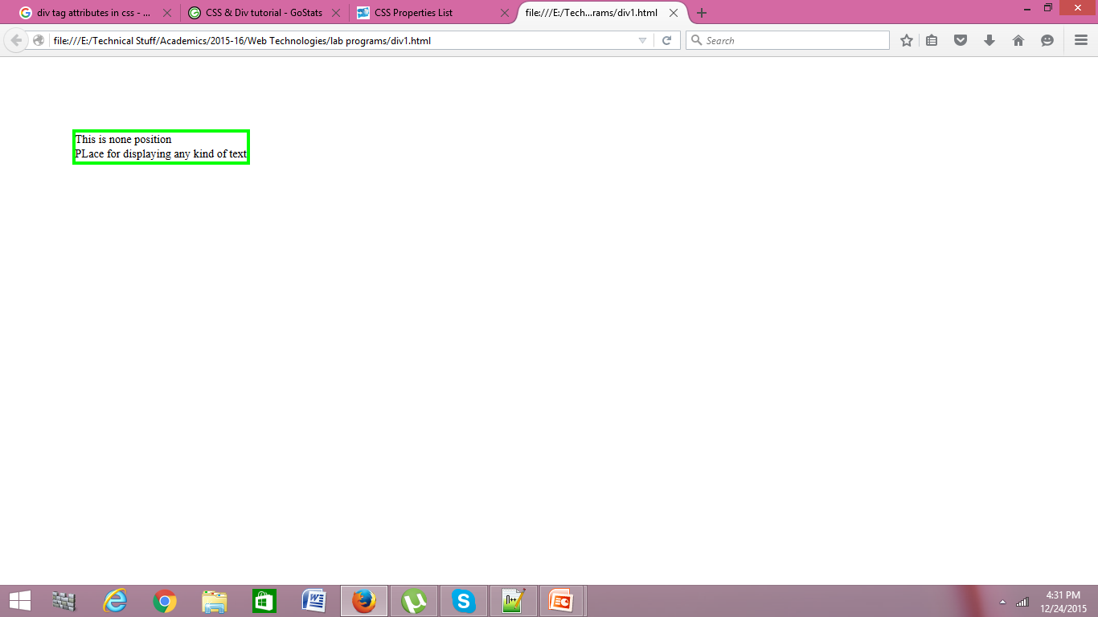
output

Slide 12
Position : static , Fixed , Relative and Absolute
<head>
<style>
div.s{
left:100px;
top:100px;
right:200px;
bottom:200px;
border:thick solid #FF0000;
position:static;
}
div.f{
left:100px;
top:100px;
right:200px;
bottom:200px;
border:thick solid #000000;
position:fixed;
}

Slide 13
cntd…
div.a{
left:150px;
top:150px;
right:100px;
bottom:100px;
border:thick solid #0FFFF0;
position:absolute;
}
div.r{
border:thick solid #0000FF;
position:relative;
background-color:orange;
}
</style>
</head>

Slide 14
Cntd..
<body>
<div class="s"> This is static position<br> PLace for displaying any kind of text<br>
</div>
<div class="f"> This is fixed position<br> PLace for displaying any kind of text<br>
</div>
<div class="a"> This is absolute position<br> PLace for displaying any kind of text<br>
</div>
<div class="r"> This is relative position<br> PLace for displaying any kind of text<br>
</div>
</body>
</html>

Slide 15
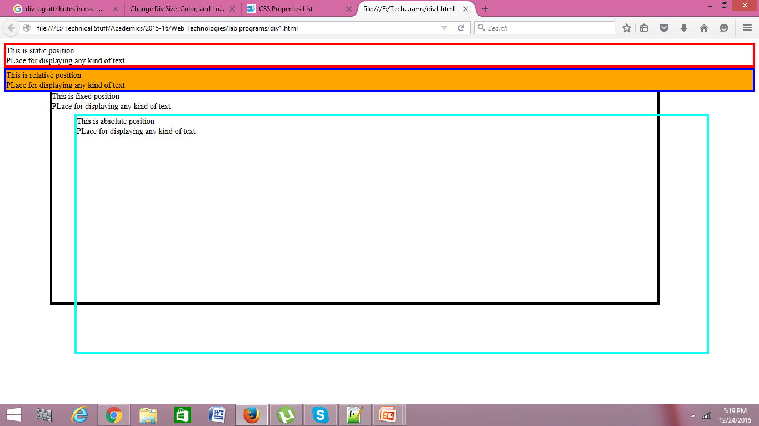
output

Slide 16
Adding background color
Add background-color:red; for ‘ a’ class
background-color:orange; for ‘r’ class

Slide 17
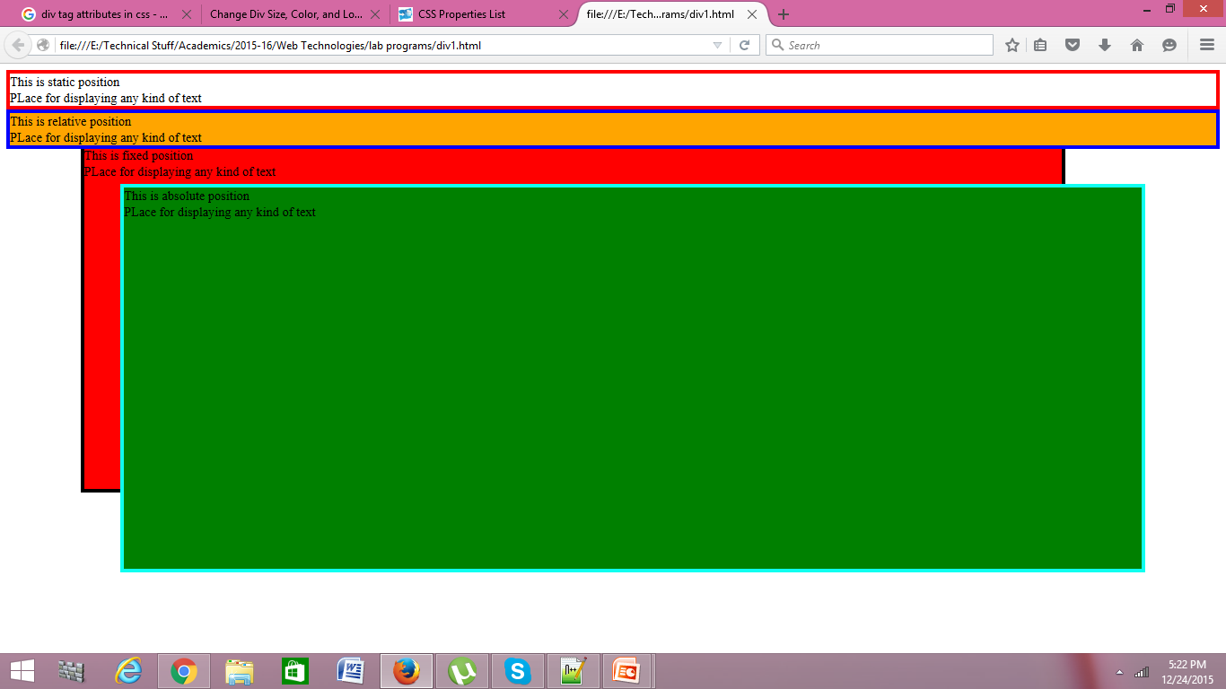

Slide 18
Another Div style
<style>
div.a{
left:100px;
top:100px;
right:10px;
bottom:10px;
border:thick solid #0FFFF0;
position:absolute;
background-color:green;
}
div.r{
left:150px;
top:150px;
right:100px;
bottom:100px;
border:thick solid #0000FF;
position:absolute;
background-color:orange;
}
</style>

Slide 19
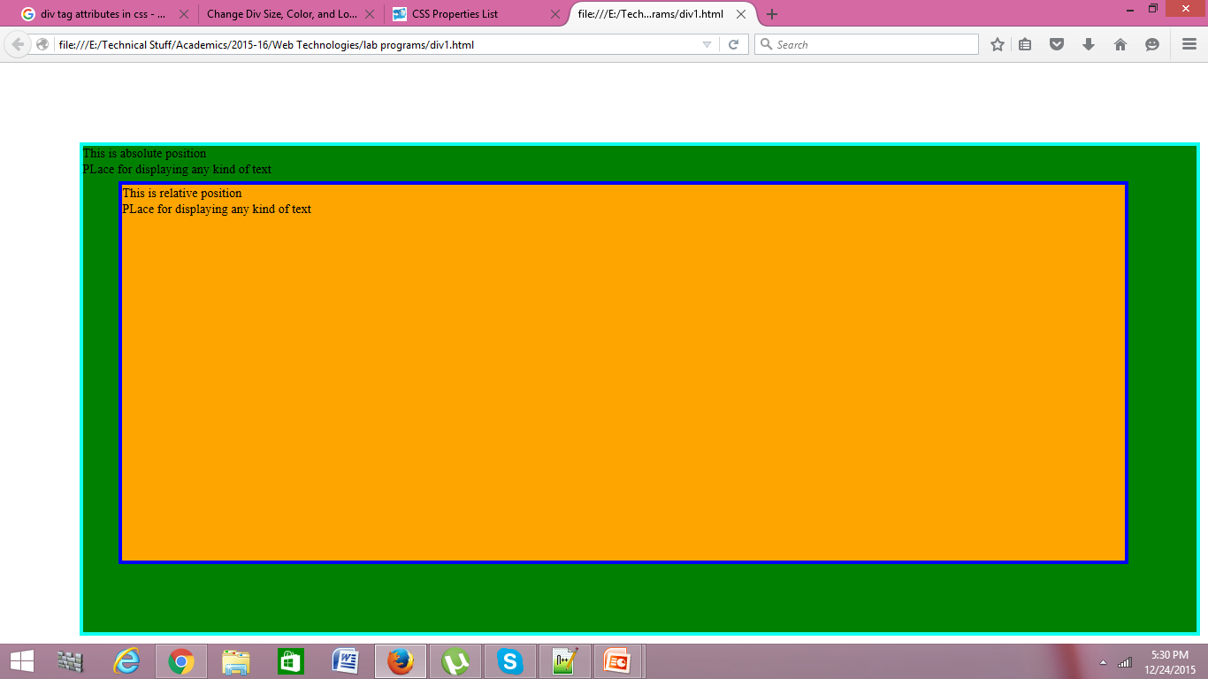
output

Slide 20
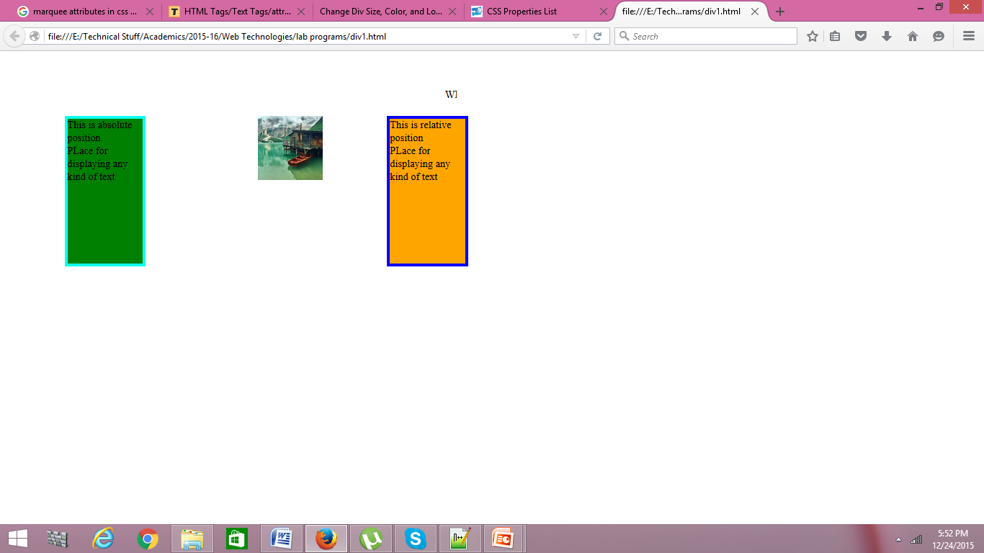
Assignment

Slide 21
solution
<html>
<head>
<style>
div.a{
left:100px;
top:100px;
right:1300px;
bottom:400px;
border:thick solid #0FFFF0;
position:absolute;
background-color:green;
}

Slide 22
div.r{
left:600px;
top:100px;
right:800px;
bottom:400px;
border:thick solid #0000FF;
position:absolute;
background-color:orange;
}

Slide 23
img{
width:100;
height:100;
left:400px;
right:500px;
top:100px;
bottom:400px;
position:absolute;
}

Slide 24
<body>
<marquee height="100" width="600" vspace="50" hspace="100"> WEBSITE for DIV Examples </marquee>
<div class="a"> This is absolute position<br> PLace for displaying any kind of text<br>
</div>
<img src="1.jpeg" alt="image displayed"></img>
<div class="r"> This is relative position<br> PLace for displaying any kind of text<br>
</div>
</body>
</html>

